Slide 1


FSU Federal Work Study Training
JENNIFER HALL- ASSISTANT DIRECTOR OF FEDERAL WORK STUDY AND LOANS
JEAN MILLS – FEDERAL WORK STUDY COORDINATOR
Notes:
Hello and welcome to the FSU Federal Work Study Training. My name is Jennifer Hall and I am the Assistant Director of Federal Work Study and Loans, along with my coordinator Ms. Jean Mills. Thank you for taking time to attend our training session today as we have a lot of new and exciting improvements to discuss!

Slide 2
Federal Work Study
Federal Work-Study (FWS) is an employment program that provides students with demonstrated financial need the opportunity to work while attending college.
FWS provides employers with financial support to help pay wages.
FWS pays a percentage of the students’ wages:
  75% paid from Work-Study Funds
  25% paid from School Funds
Notes:
The Federal Work Study Program (FWS) provides students that demonstrate financial need the opportunity to work while attending college. FWS provides employers financial support to help pay wages. 75% is paid from FWS funds and 25% is paid from school funds.

Slide 3
Federal Allocation
3,000,000
2,500,000
2,000,000
1,500,000
1,000,000
500,000
0
2016-2017
2017-2018
2018-2019
2019-2020
2020-2021 (COVID)
2021-2022
Notes:
Federal Allocation and Earnings
As you can see indicated on the chart our program has increased each year in funding. Even during COVID, we were able to expended all unused funding to our students through Emergency SEOG.

Slide 4
Number of Students Employed thru FWS Program
1200
1000
800
600
400
200
0
2016-2017
2017-2018
2018-2019
2019-2020
2020-2021 (COVID)
2021-2022
Notes:
Number of Students Employed thru the FWS Program
As you can see due to COVID that the number of students did decreased this previous year. However, we do expect these to return to normal as campus is repopulating.

Slide 5
Policies
Both Undergraduate/Graduate Students are required to have completed Financial Aid process and be awarded. Must have unmet financial need determined by the FAFSA to review eligibility for the work study program
Students must be enrolled in at least 6 credit hours and making SAP (Satisfactory Academic Progress)
Scheduled hours are not to exceed 28 per week Friday through Thursday, on average most students work between 12-15 hours per week
Students may work only one FWS job at a time
Students may have more than one type of job on campus (Example: FWS and OPS) but the combined hours appointed and worked cannot exceed 28 hours per week (Friday-Thursday); A dual compensation form is required (if positions are within different departments).
Rate of pay should be based on responsibilities and experience
Florida Minimum Wage starts at $11.00 (effective 9/30/22)
Notes:
Policies

Slide 6
FWS Processing Timeline
Students complete the FAFSA at studentaid.gov and select that they are interested in Federal Work Study- Starting in October 2021
OFA Awards: Initial packaging starts in March 2022 and ongoing
Students Accept Awards: March 2022 and ongoing
Department Creates Job Openings: May 2022 for fall semester and updated each semester that new hires are needed

Slide 7
FWS Process Timeline (continued)
Students Apply for Jobs: June 2022 for fall semester
Department reviews applications, interviews, and hires student: Starting in June 2022 and continuing through the fall semester
Department submits Job Offer or Electronic Personnel Actions (ePaf): June 2022 and continuing through fall semester
OFA completes FWS hiring process: June 2022 and ongoing until job listing is closed

Slide 8
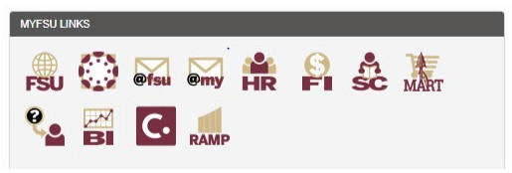
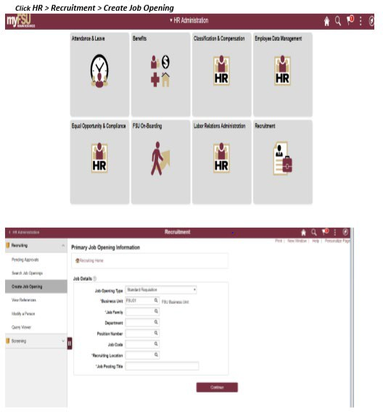
Create Job Listing
Create Job Opening (in OMNI HR)
  Access is available to users with FSU_SS_MANAGER role: Go to https://my.fsu.edu and sign into OMNI HR with your FSUID and password. Click the HR icon.
Notes:
Now, let’s discuss how to create a job listing. All processes and workflows will be provided on our webpage at finanicalaid.fsu.edu.
First, you must be logged into OMNI HR and have access to the SS_Manager role.
Select Create Job listing

Slide 9
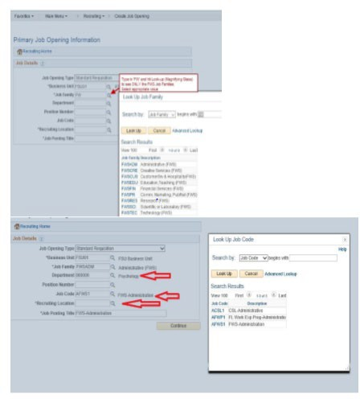
Complete fields on the Primary Job Opening Information tab as demonstrated below, selecting the appropriate Federal Work Study Job Family and appropriate Job Code. Enter the Department Number and Recruiting Location. (Leave the Position Number blank.)
The Job Posting Title should be updated to something more specific and meaningful for FWS applicants while keeping “AFWS” or “ACSL” in the title (e.g., AFWS_FA22_Psychology_Office Assistant.)
Click Continue once complete.

Slide 10
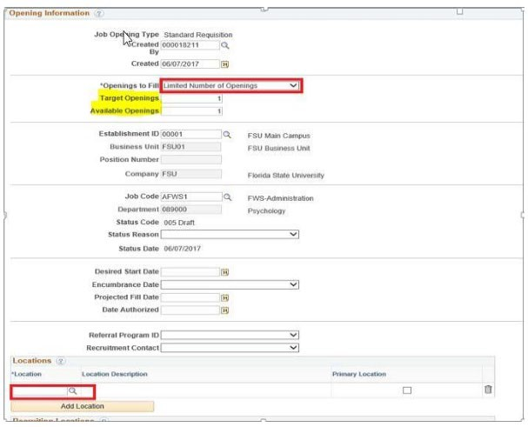
Job Information Tab – If the same Job Posting will be used to fill more than one opening, the “Target Openings” and “Available Openings” should be adjusted to reflect the number of hires needed; however, the jobs MUST be identical to use this feature. If the duties differ, create another job opening. Otherwise, the only entry needed on this page is “Location”. Enter the “Location ID” for the office location
of where the work will be performed.

Slide 11
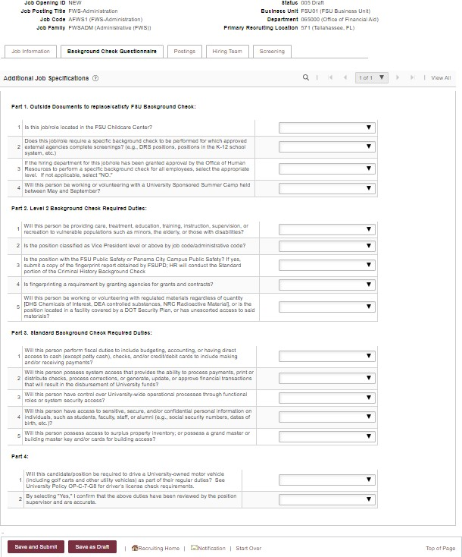
Please answer the Additional Job Specifications of the Background Check Questionnaire tab based on the job description:
Part 1. Outside Documents to replace/satisfy FSU Background Check
Part 2. Level 2 Background Check Required Duties
Part 3. Standard Background Check Required Duties
Part 4. Additional Questions
11

Slide 12
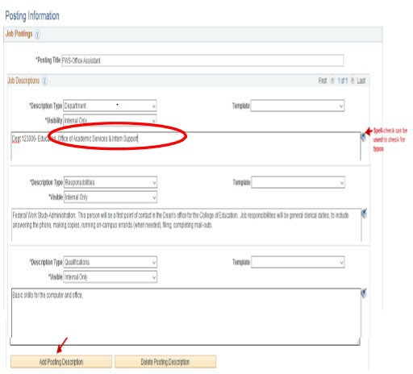
Job Posting Tab – Below is the required fields about the job listing, as it will display to the applicants on the FWS Job Site.
Select and enter information for each “Description Type” that you want displayed to the applicant. The required fields are as follows:
Department
Responsibilities
Qualifications
Schedule
Contact Info (indicate direct supervisor email and phone number)
*Criminal Background Check (if required)
*How to Apply (Federal Work Study Application Instructions)
*Tobacco Free Campus
*Equal Employment Opportunity
*** The descriptions marked with an asterisk indicates a template must be chosen from the drop-down menu to populate standard language. Do not alter the standard language.
Note -- The Visibility must be set to Internal Only for each description on the FWS job listing.
12

Slide 13
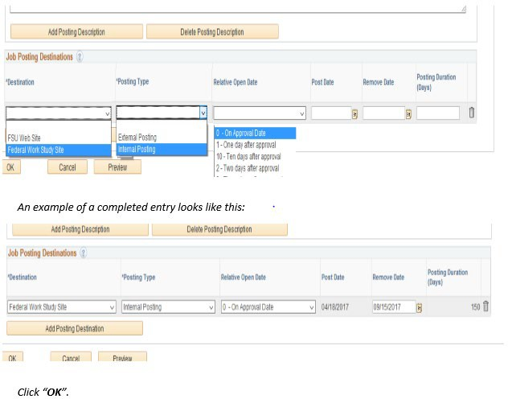
Relative Open Date can be left at “0-On Approval Date.” Positions should be advertised for a minimum of 7 days, however, the job listing can be advertised as long as needed.
**** DO NOT ENTER A 01-01-9999 DATE.
After all “Posting Information” is entered, complete the Job Posting Destination Information section, at the bottom of this same tab.
Delete the “External Posting” by selecting the trash can icon. Under the destination type select “Federal Work Study Site” and posting type “Internal Posting” then save.

Slide 14
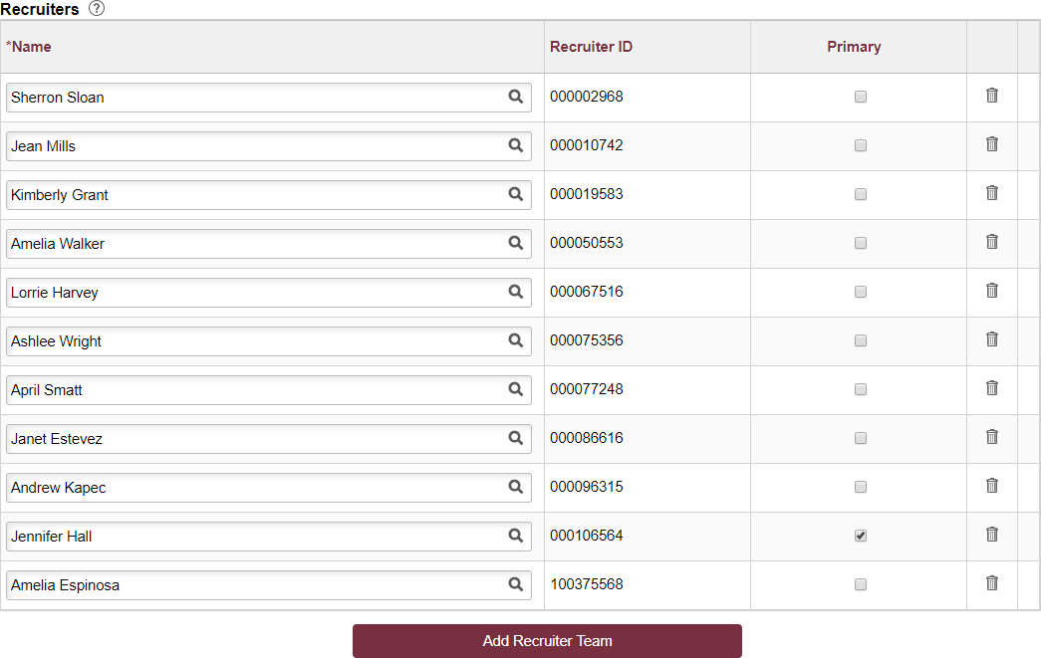
Hiring Team Tab – Under “Recruiters” Select “Add Recruiting Team” and check the box next to FWS Recruiters (OFA Staff). Check Primary Recruiter- Jennifer Hall

Slide 15
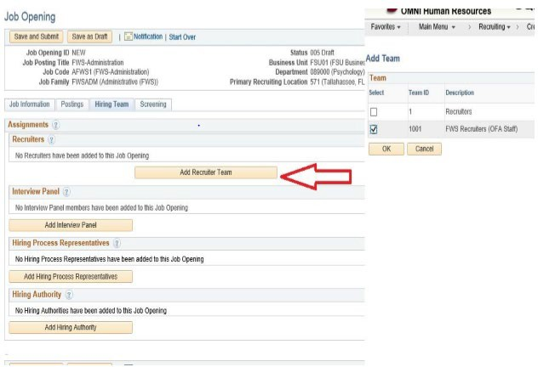
Add the appropriate employees to the Interview Panel Hiring (Add supervisors who need to view applications here)
Hiring Process Representatives (Indicate HR Rep)
Hiring Authority (Optional)

Slide 16
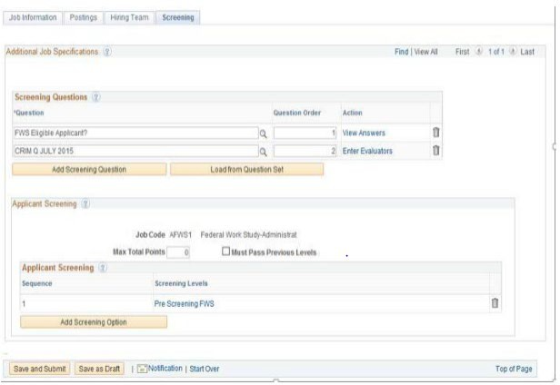
Pre-Screening Tab – All necessary information will default in. No entries are required by the user.

Slide 17
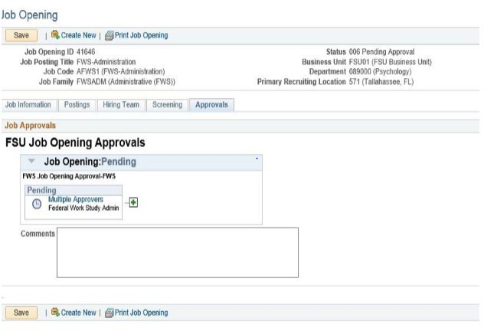
Submit Job Opening for Approval
Hit “Save and Submit” and the Job Opening will be routed for approval. Approvals Tab will display, showing where the Job Opening is routed
The FWS Recruiter will review the job posting, if all required fields are complete posting will be approved
If corrections are needed, the FWS Recruiter will contact the department for any necessary changes
Once approved, the originating department will receive an email confirmation that the listing is approved
17

Slide 18
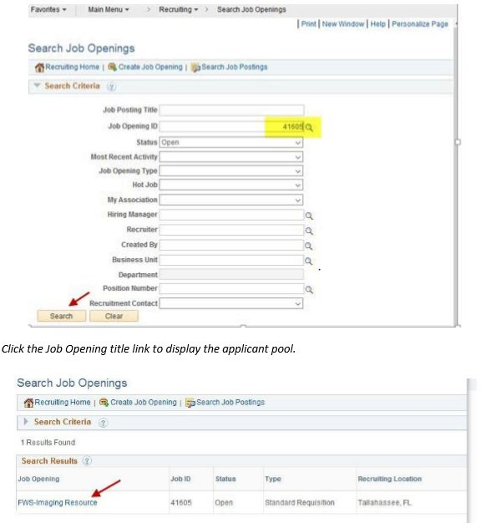
Hiring Department Reviews Applications
Search Job Openings
Users must be listed on the “Hiring Team” field to have access to view the applications
Click HR > Recruitment > Search Job Openings. Enter the appropriate “Job Opening ID” number (or other criteria) & click “Search”

Slide 19
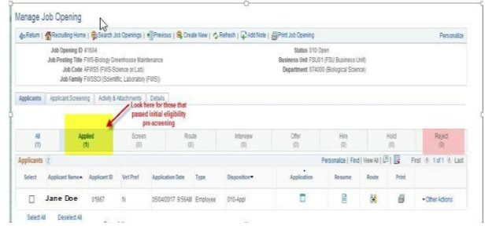
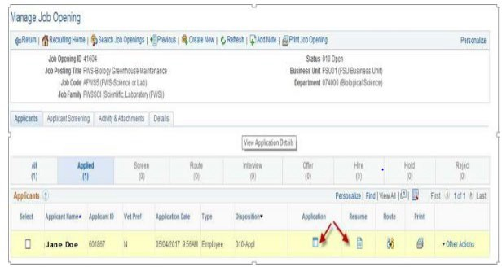
Review the applicants that show on the “Applied” tab, as these are the individuals that passed the pre- screening questionnaire and are eligible for consideration. (The “Reject” tab shows any applicants that failed pre-screening because they indicated they were not eligible for FWS.)
Click the Application icon to view all application details, as well as any resume and/or other attachments, (including the FWS Authorization Form, which the FWS applicant is required to include as proof of eligibility). To view just the applicant’s resume, (if included), click the Resume shortcut icon.

Slide 20
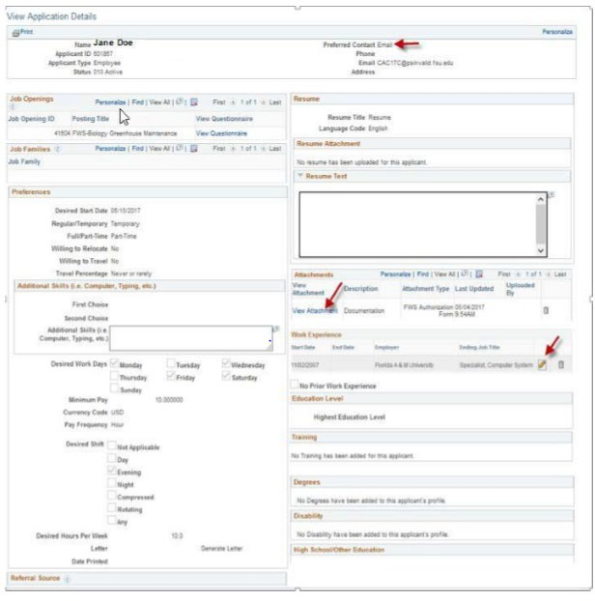
When viewing the Application, verify that the FWS Authorization Form is attached
Note the “Preferred Contact” method when contacting an applicant for an interview
The Pencil icon next to any Work Experience entry can be used to view details of the job responsibilities, etc

Slide 21
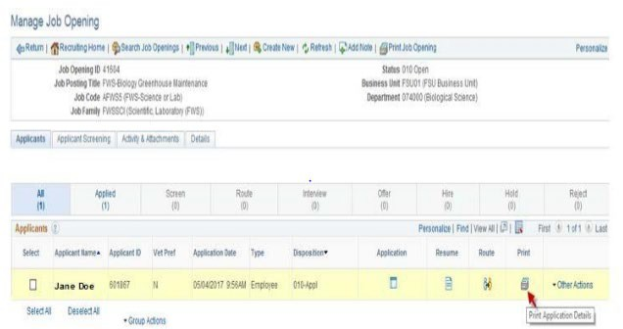
The Print icon found in the Print column can be used to individually generate the details of the application in PDF format, along with any attachments the applicant submitted.

Slide 22
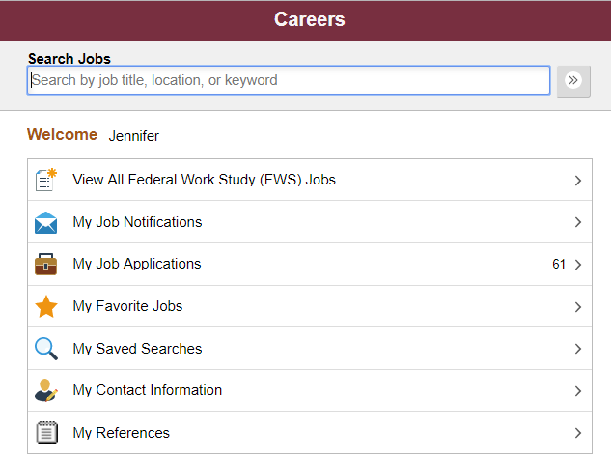
Student’s View of the Work Study Job Portal

Slide 23
Overview
FSU HR/FWS Online Job Opening
  Department/HR Rep creates and submits position job opening and integrated background check requirement
  Upon FWS Recruiter approval, the job opening becomes available for students to view immediately
  Student must accept their work study award prior to reviewing job openings
  After departments review applicants, they should contact student for an interview and hire-
    Think about interviewing by phone/Teams/Zoom to get the process going before the student arrives on campus

Slide 24
Overview (Continued)
Reasons a student is not able to view/accept FWS award
Has outstanding Financial Aid documents
Is not making SAP (Satisfactory Academic Progress), which makes the student ineligible to participate in the Work Study Program
Has not accepted award
No longer eligible due to change in financial aid package, cancellation, or not enrolled for 6 credit hours

Slide 25
Candidate Selection/Ready to Hire
Final step once a candidate has been selected:
Review the background check requirements for the position on the job opening. For further information please refer to: https://hr.fsu.edu/?page=ers/bgc/1-home
If a background check is required, please complete a Request Form using the Background Check Forms Portal to initiate the appropriate background check. Go to https://hrapps.fsu.edu/background_check_portal/index.cfm?page=home#/
Once you have received an email from Human Resources that the candidate has been approved for hire, an offer of employment can be made

Slide 26
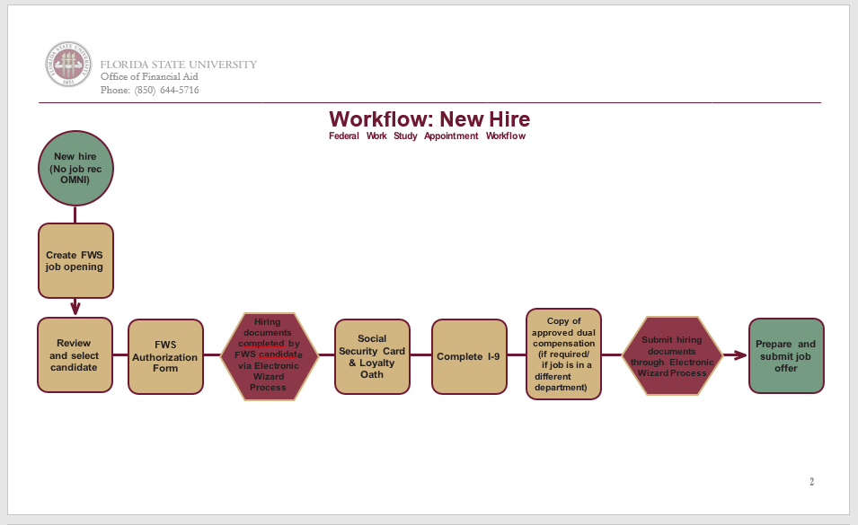
Notes:
Now, we will discuss the different types of Workflows and the Appointment Matrix: There is a
New Hire
Continuing Employee
Rehire
Changes/Terminations and
Appointment Matrix
This workflow is for a new hire. A new hire will not have a job record in OMNI. You will begin by creating an FWS Job Opening then Review and Select the candidate: Once the candidate has been selected

Slide 27
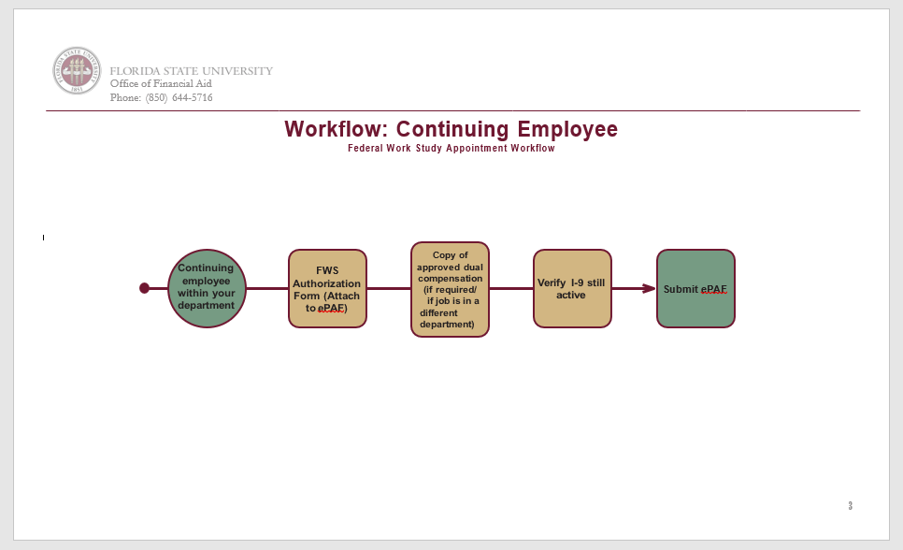

Slide 28
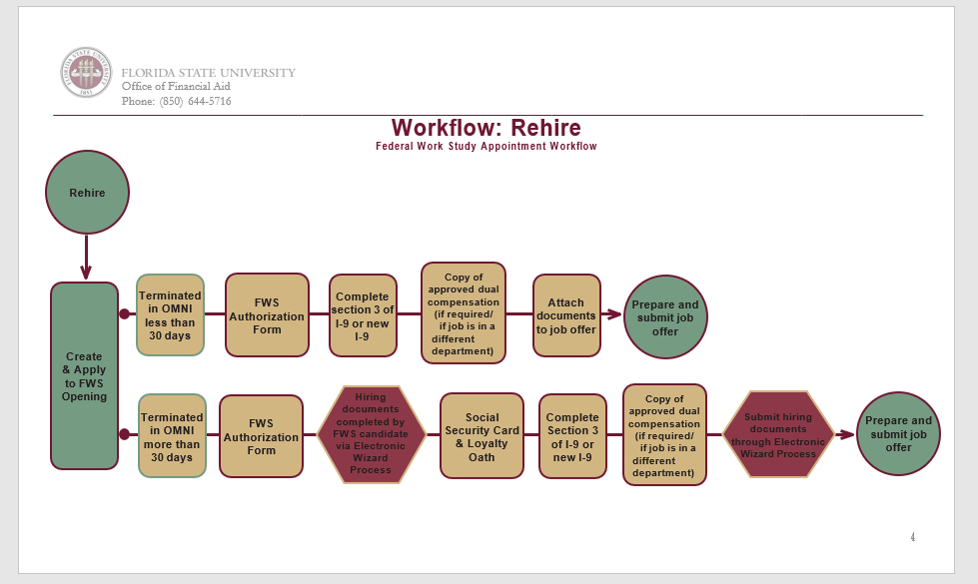

Slide 29
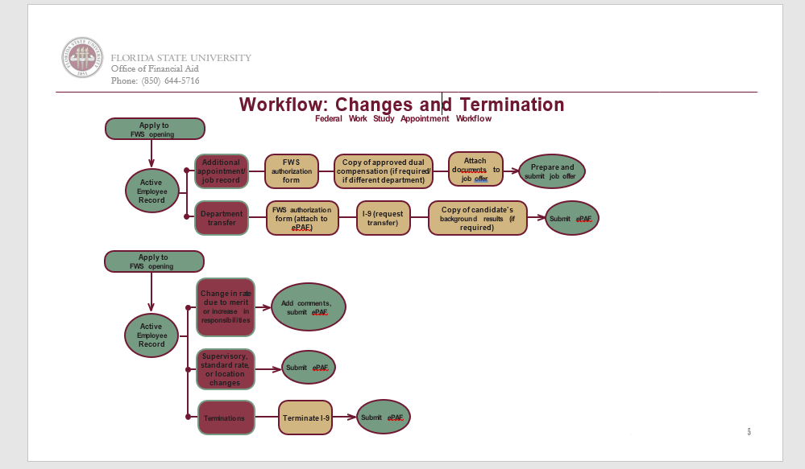

Slide 30
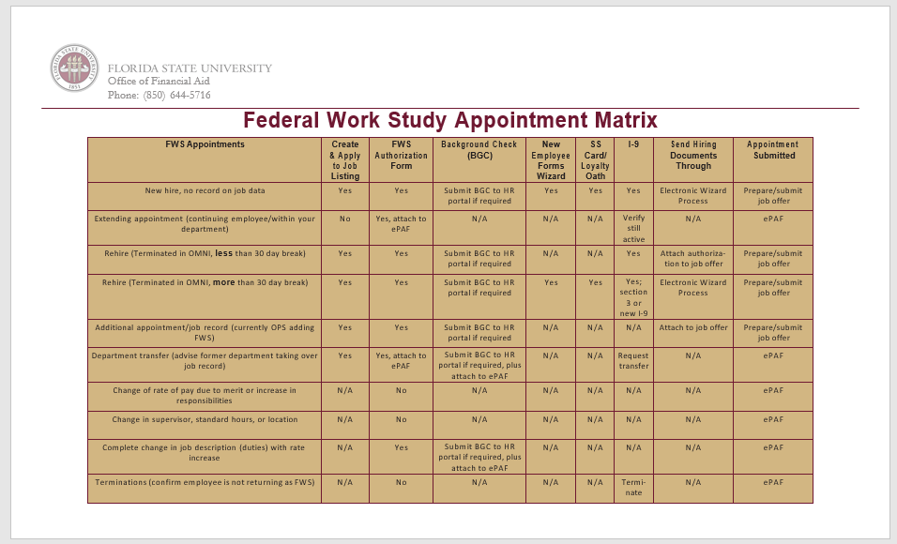
Notes:
The Appointment Martix is a quick reference that allows you to determine the steps for each workflow.

Slide 31
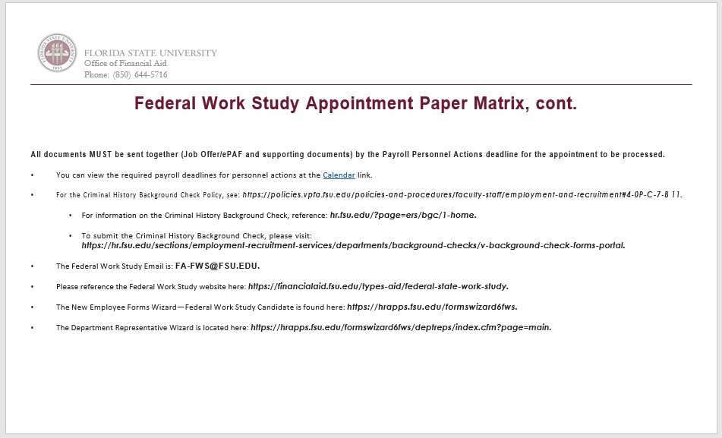

Slide 32
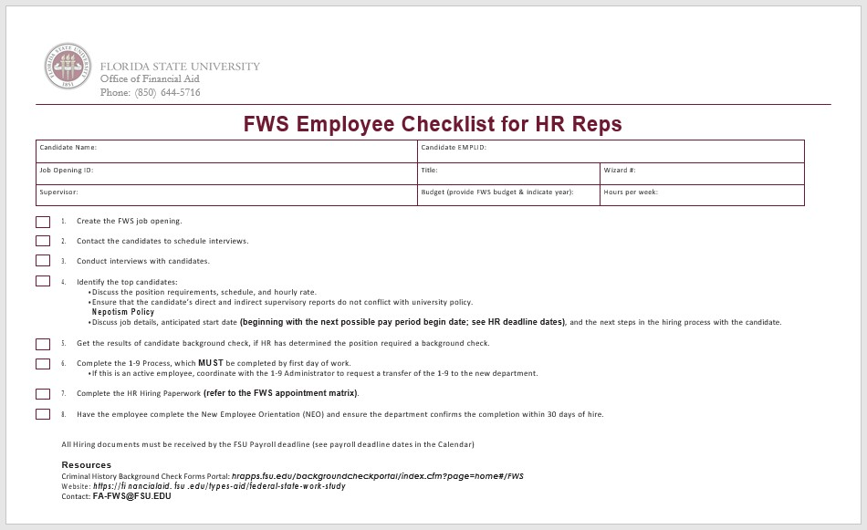

Slide 33
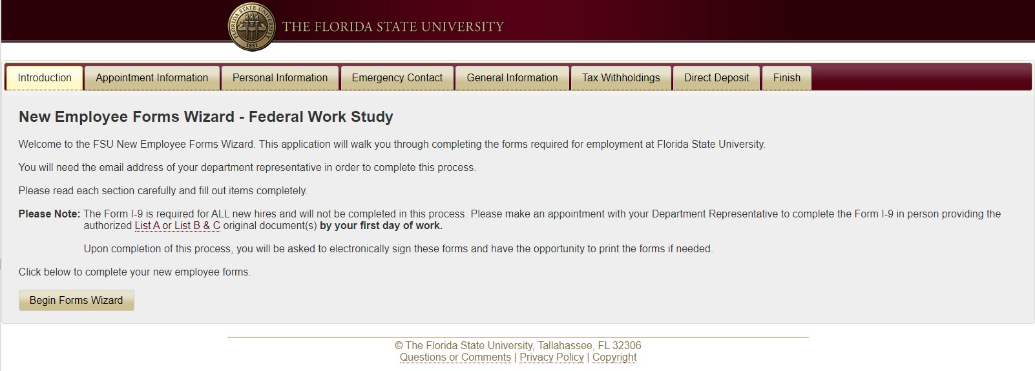
e-Wizard from Students view
https://hrapps.fsu.edu/formswizard6_fws/
Notes:
This is the student’s view of the wizard.

Slide 34
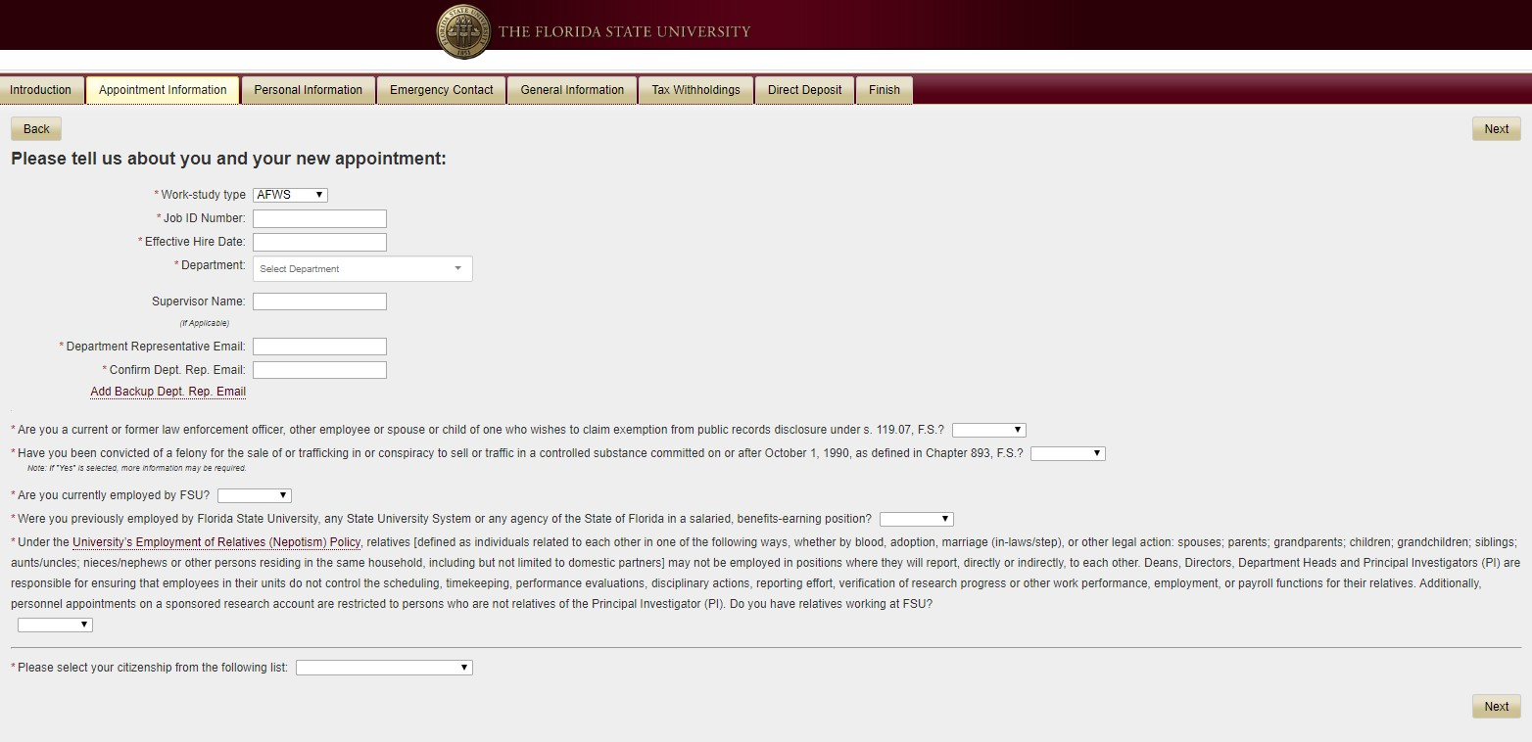
Students View- Part 2
Candidates completes each tab below and confirms information is accurate

Slide 35
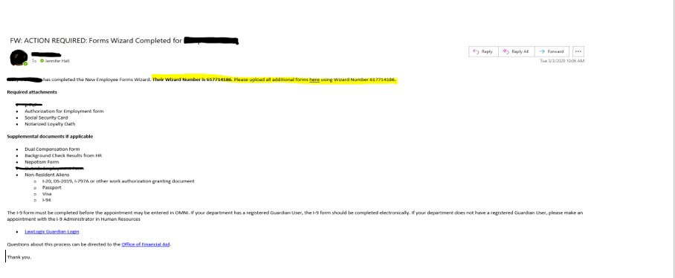
Email confirmation that HR Reps will receive once student has completed the e-Wizard
Copy and paste Wizard Number and click “here” to upload additional documents needed.

Slide 36
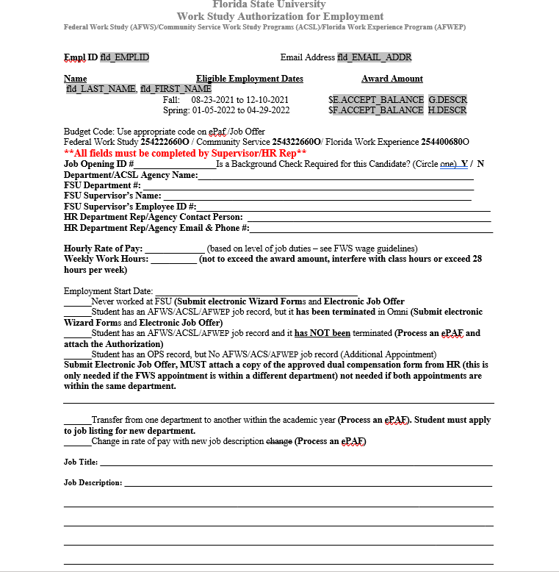
Authorization for Employment (Page 1 of 2)
The following fields must be completed on the form:
Job Opening ID#
Background Check Requirement for Candidate
FSU Department #
FSU Supervisor Emp ID #
FSU Supervisor Name
Dept or Agency Name
Dept or Agency Contact Person
Dept or Agency contact person email and phone number
Hourly Rate of pay
Weekly Work hours
Employment Start Date
Select Appropriate Action
Job Title
Job Description
*MUST ATTACH AUTHORIZATION for EMPL to e- PAF/Job Offer FOR PROCESSING.
35

Slide 37
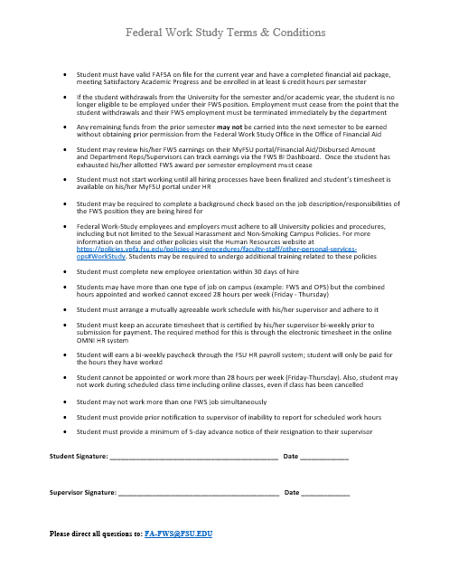
Authorization for Employment (Page 2 of 2) Terms and Conditions
***Student and Supervisor signature is required

Slide 38
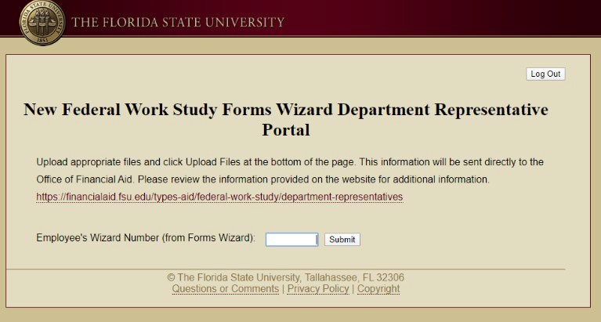
E-Wizard Department Representative Portal
https://hrapps.fsu.edu/formswizard6_fws/deptreps/index.cfm?page=main
After login paste the wizard number and submit
*** Wizard number is provided on email from the student after the completion of the e- Wizard.
38

Slide 39
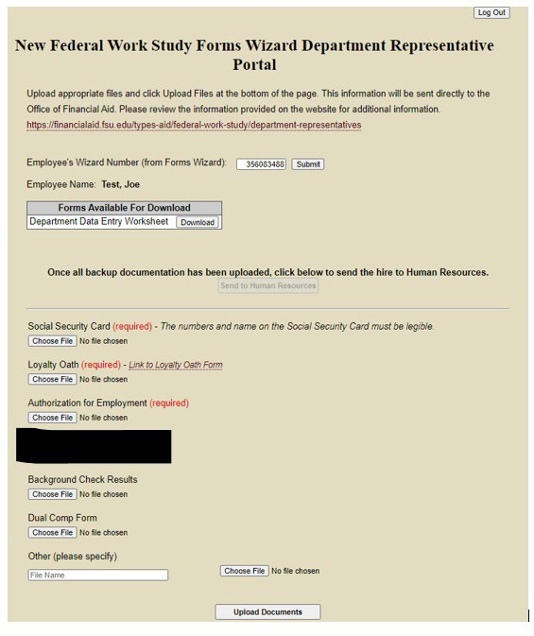
Please upload the following required supplemental documents:
Social Security Card
Notarized Loyalty Oath
Authorization form
Nepotism form (if required)
Background Check Results (if required)
Dual Compensation (if required)
Others such as:
Non-Resident Aliens
I-20, DS-2019, I-797A or other work authorization granting document Passport
Visa I-94

Slide 40
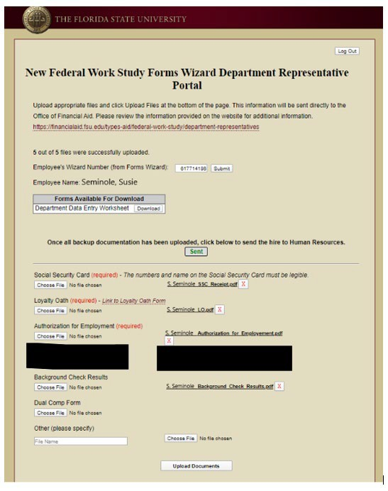
Confirmation that documents have been sent via e-Wizard

Slide 41
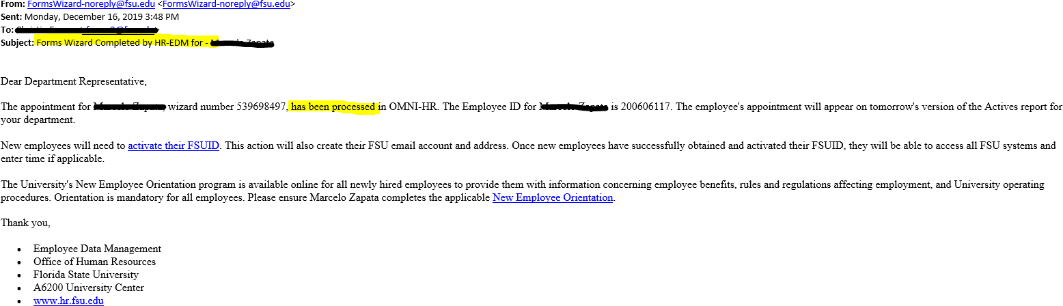
Email confirmation received when e-Wizard has been finalized

Slide 42
I-9 Process
I-9 information link: https://hr.fsu.edu/?page=edm/i9/i9_home
All Federal Work Study employees must complete a I-9
When must the Form I-9 be completed?
  After acceptance of their Job Offer
Section 1 - no later than their first day of work for pay
Section 2 - no later than the third business day employee starts work for pay
  If work lasts less than three days, Section 2 must be completed no later than first day of work
for pay
  If Section 2, cannot be completed by required schedule, work must stop until documents can be presented to complete Section 2
What is needed to complete the Form I-9?
Original, authentic, unexpired, valid, and acceptable documents listed on the "Section 2 of Form I-9" Page of this Instructional Website
  Copies and scans are invalid as they are not original or authentic.
Hire date
  If the employee's hire date changes after the completion of the Form I-9, notify the I-9 Administrator for the hire date to be amended on the I-9

Slide 43
I-9 Process (continued)
Who acts as the Employer or Authorized Agent to complete Section 2 of Form I-9?
All trained FSU Department Representatives who have access
to the online I-9 software, Guardian, have the authority to complete Section 2 as the Employer.
  I-9s completed on campus are done electronically using the Guardian system
If working remotely, authorization is given via the Remote Hire
Authorized Agent Form to Public Notaries or other university HR representatives to act as FSU's Authorized Agent.
  I-9s completed remotely are completed electronically via Guardian. Please review the Electronic Remote I-9 Process.
To Rehire
  For more detailed instructions follow link provided:
  https://hr.fsu.edu/?page=edm/i9/i9_06_section_3

Slide 44

OMNI HR Training Guide
Creating a Job Offer from an Advertised FWS Job Opening
Required Role: FSU_SS_MANAGER Understanding the process:
Departments can create their own FWS job openings from which to recruit and hire FWS candidates. This topic details the steps to create a job offer from an advertised FWS job opening in OMNI HR.
The hiring department must ensure that the top candidate qualifies, is interviewed, and pre-employment checks are completed; however, with regard to system coding, the
department does not have to request applicants to be routed, create interview evaluations, record disposition codes, or complete the pre-employment checklist in OMNI for FWS candidates.
Submit Background Check through Background Check portal:
  https://hrapps.fsu.edu/background_check_portal/index.cfm?page=home#/
Check OMNI to determine if student has active FWS record
  If active FWS record, then submit ePaf
  If not, then the candidate must complete the FWS wizard in addition to submitting the job offer
Once the department has discussed the rate of pay and anticipated start date with the candidate. At this stage, a formal job offer should not be made. This is because the hiring processes, to include a criminal history background check (if needed), have yet to be completed.
Last updated 5/26/2020
1

Slide 45
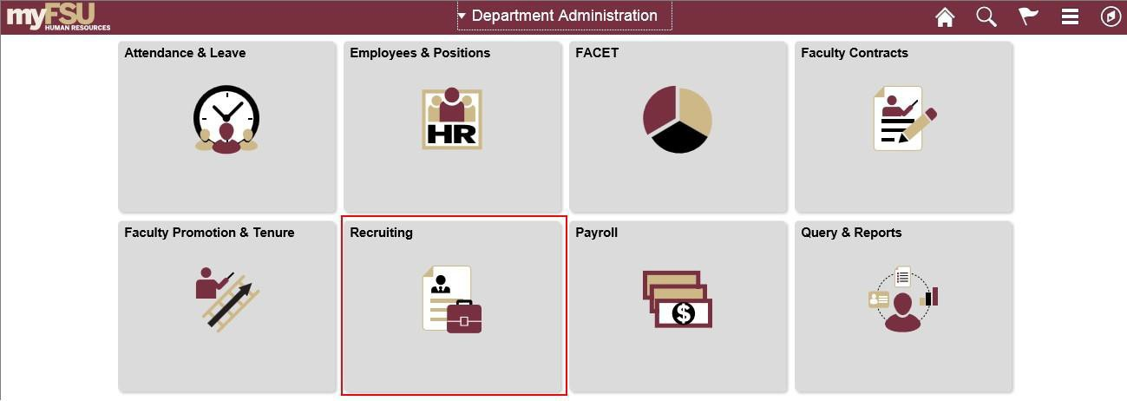
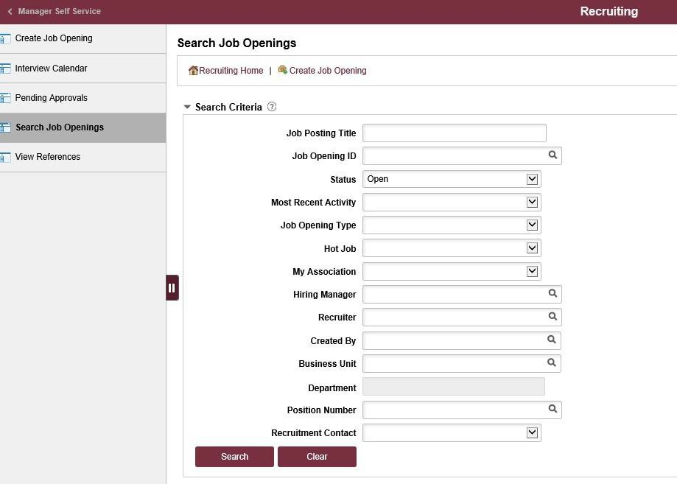
Step | Action
1. | Once logged into OMNI HR > select the Department Administration page > click the Recruiting tile.
Step | Action
2. | Click the Search Job Openings tab.
Last updated 5/26/2020
2

Slide 46

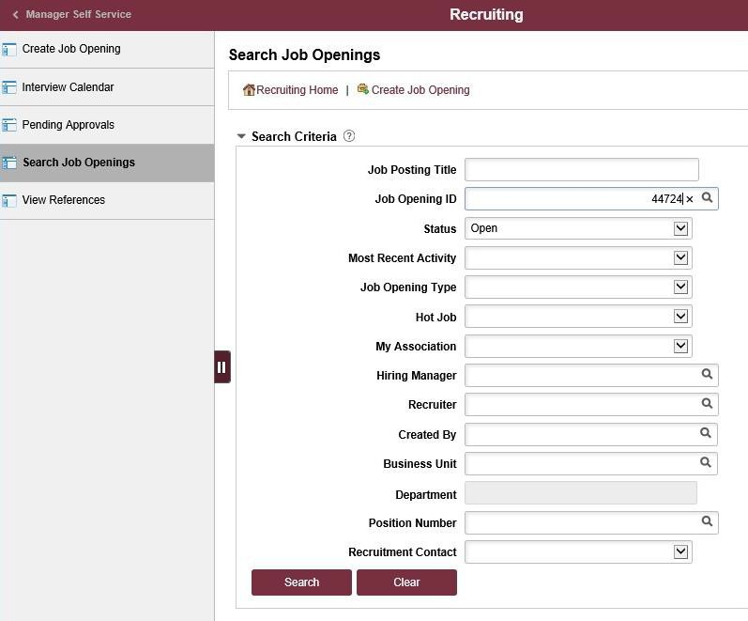
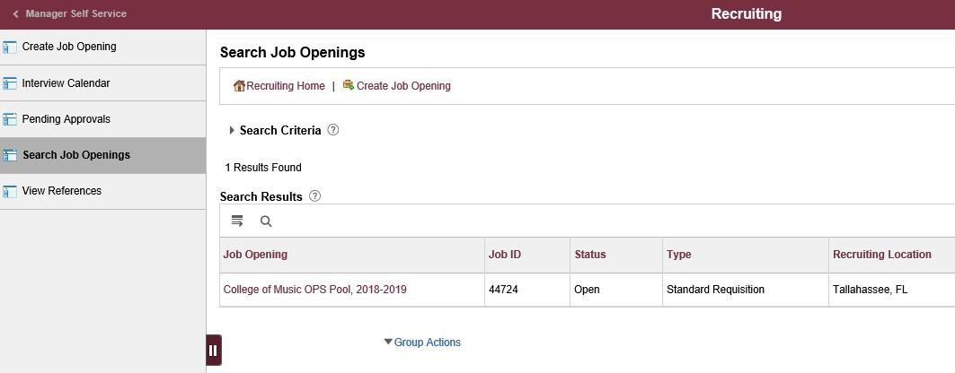
Step | Action
3. | Enter the desired Job Opening ID. Click the Search button.
Step | Action
4. | Click the desired Job Opening link.
Last updated 5/26/2020
3

Slide 47
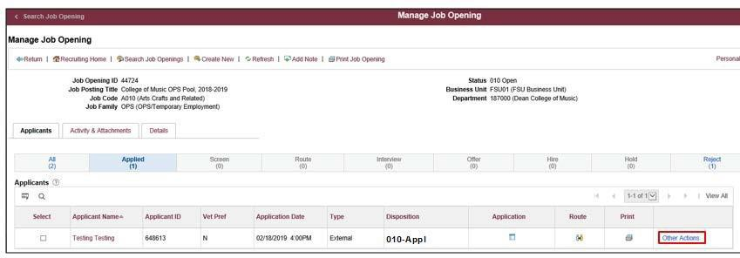
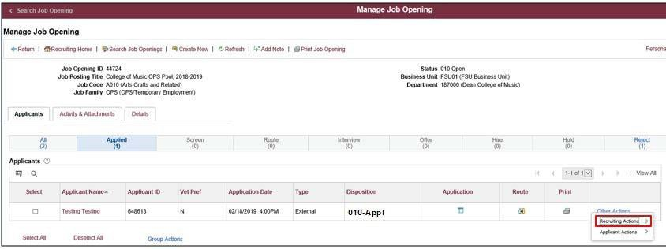
Step | Action
5. | Click the Other Actions dropdown list across from the selected applicant’s name.
Step | Action
6. | Click the Recruiting Actions dropdown list.
Last updated 5/26/2020
4

Slide 48
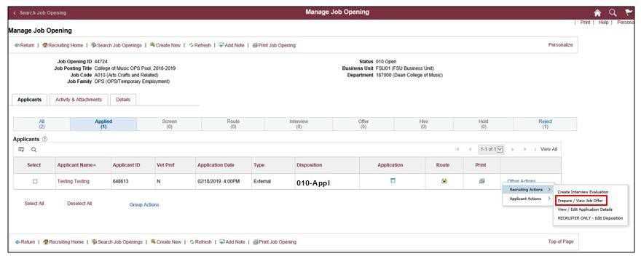

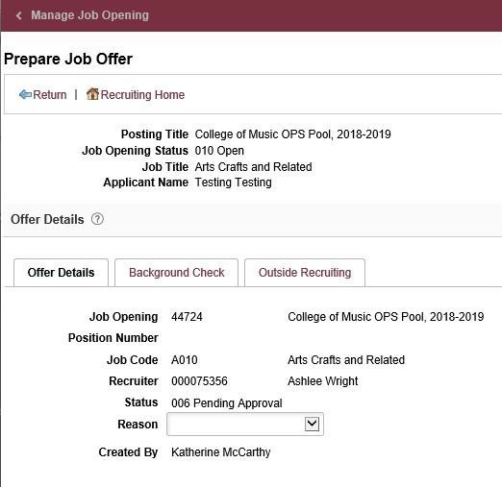
Step | Action
7. | Click Prepare / View Job Offer.
Step | Action
8. | Begin on the Offer Details tab. Note: Much of the data on the Offer Details page will populate from the job opening.
Last updated 5/26/2020
5

Slide 49
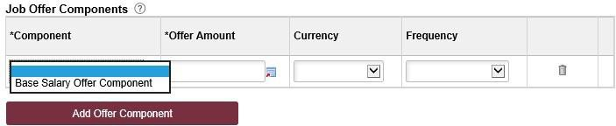
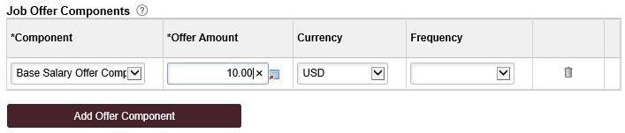
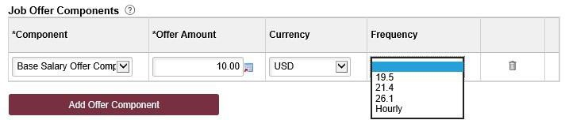
Step | Action
9. | Navigate to the Job Offer Components section. Click the Component list. Click the Base Salary Offer Component list item.
Step | Action
10. | Enter appropriate hourly rate of pay. Currency should be USD.
Step | Action
11. | Select an "Hourly" Frequency.
Last updated 5/26/2020
6

Slide 50
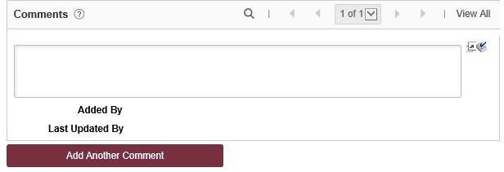
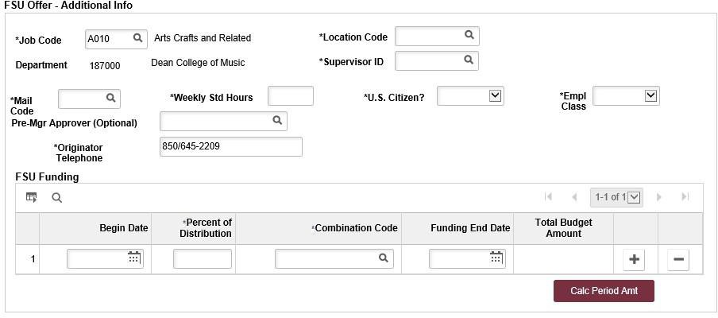
Step | Action
12. | Navigate to the Comments section. Enter information pertaining to the applicant and/or job offer, such as employee ID (if a previous employee), type of appointment (new, rehire, additional appointment), and wizard # etc.
Step | Action
13. | Navigate to the FSU Offer – Additional Info section. If the candidate applied as an existing or former employee, the Employee Id field and number will display at the top of this section. The Job Code will automatically populate from the job opening.
Last updated 5/26/2020
7

Slide 51
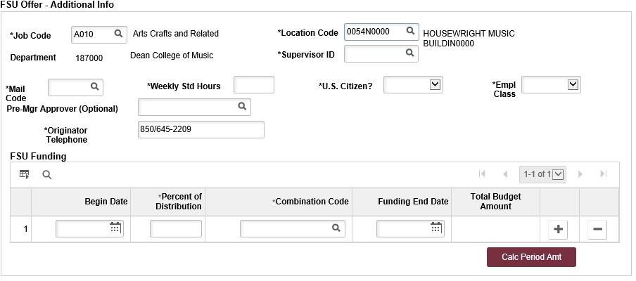
Step | Action
14. | The Department will automatically populate from the job opening.
Step | Action
15. | The Location Code populates from the job opening. If needed, use the lookup button to search for and select the desired Location Code.
Last updated 5/26/2020
8

Slide 52
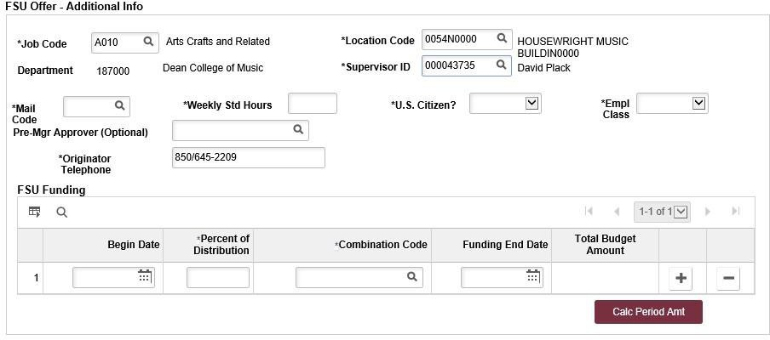

Step | Action
16. | Enter the appropriate Supervisor ID or use the lookup icon to search for the desired Supervisor ID.
Step | Action
17. | Enter the appropriate Mail Code or use the lookup icon to search for the desired Mail Code.
Last updated 5/26/2020
9

Slide 53
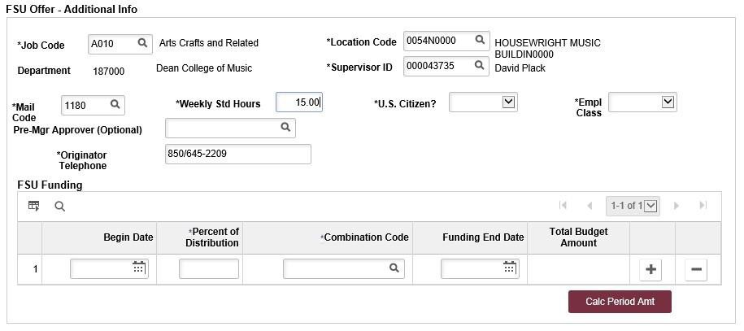
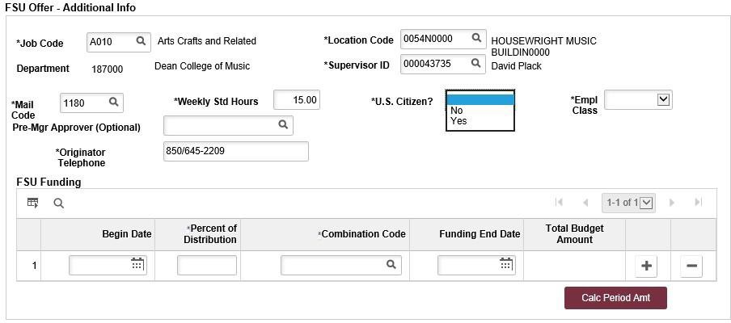
Step | Action
18. | Enter the appropriate Weekly Std Hours.
Step | Action
19. | Click the U.S. Citizen? list. Select the appropriate answer which is indicated on the Data Entry Worksheet.
Last updated 5/26/2020
10

Slide 54

Step | Action
20. | The appropriate Empl Class will automatically populate based on the selected job code ("OPS" for FWS job offers).
Step | Action- **Opitional
21. | The Pre-Mgr Approver field is optional. Use the lookup button to search and select a Pre-Mgr Approver, if desired. The Originator Telephone will automatically populate.
LOYD, NORA | [SCHOOL]

Slide 55

Step | Action
22. | Enter the Begin Date. Start dates should be 2 - 3 weeks out to allow time for approvals. Reference Payroll Deadlines for Personnel Actions.
Step | Action
23. | Enter the appropriate funding distribution information into the Percent of Distribution field. Note: The total Percent of Distribution must equal 100%.
LOYD, NORA | [SCHOOL]

Slide 56

Step | Action
24. | Enter the appropriate funding FWS Combo (budget) Code indicated on the FWS Authorization form. The code must contain the letter “O” at the end the end of budget code
Step | Action
25. | Enter the appropriate Funding End Date. All FWS job offers must have a Funding End Date.
LOYD, NORA | [SCHOOL]

Slide 57




Step | Action
26. | Click the Calc Period Amt button to calculate the Total Budget Amount.
Step | Action
27. | Click the Background Check tab.
LOYD, NORA | [SCHOOL]

Slide 58

Step | Action
28. | The Level of Background Check Required will auto-populate from the Background Check Questionnaire on the Job Opening. Enter a Description of Duties for the appointment or state “refer to job opening”. Enter comments as needed. Confirm the Budget Manager and Budget Manager Email is correct. Enter or look up a valid Purchase Order # and Line # for the background check. The Line # will generate based on purchase order selected.
LOYD, NORA | [SCHOOL]

Slide 59

Step | Action
29. | For Questions 1, answer “No” for FWS. For Question 2, answer "Not Applicable" for FWS job offers.
LOYD, NORA | [SCHOOL]

Slide 60


Step | Action
30. | Click Save as Draft to save
Step | Action
31. | After saving as a draft, edit document to add attachments.
***new screen- add how to save as a draft before submitting for approval
LOYD, NORA | [SCHOOL]

Slide 61


Step | Action
31. | After you have submitted the job offer with attached authorization form, a confirmation message pops up. Click the OK button.
LOYD, NORA | [SCHOOL]

Slide 62

Step | Action
32. | Navigate to the Approvals tab to review the status of the job offer in the workflow. To insert an additional approver, click the plus sign at the desired point, ensuring that the FWS Recruiter is listed last. Approval goes to Dept. Manger/Background Check Approver/FWS Recruiter. NOTE: To check the status of a job offer, go to Recruiting > Search Job Openings > across from the candidate’s name, click Other Actions > Recruiting Actions > Prepare/View Job Offer > Approvals tab. To make edits, click Edit Offer and make the changes > Calc Period Amount > Submit for Approval.
Congratulations! You have completed the topic.
Questions on this procedure? Contact FWS at FA-FWS@fsu.edu
LOYD, NORA | [SCHOOL]

Slide 63
How to determine if my Work Study student is ready to begin working:
ONLY allow student to start working after verifying that they have been hired/appointed in the system by viewing:
Departmental Active Employee list
OMNI Job Data
View student employee timesheet
49

Slide 64

e-PAF(sample)
Used for Continuing Employees and Changes Only
Notes:
ePaf This is a sample of an ePaf that is used for continuing employees and changes only. Take note of the highlighted paperclip (view attachments). You will attach the completed authorization form when processing a continuing employee.

Slide 65

e-PAF
(continued)
Check box: Allow Gaps in Funding Dates.
Fall 2022 Semester- 08/22/22 - 12/09/22
Spring 2023 Semester- 01/09/23 - 05/05/23
Note: Account Code 254223660O-FWS
254323660O-CLSP
254400680O-FWEP

Slide 66
Reminder: Timesheets
Refer to the FSU Payroll Calendar to ensure submission by last day of pay period (Subject to change during holidays)
Student may work up to a maximum of 28 hours weekly Friday through Thursday (NO EXCEPTIONS)
Student may only work up to allotted award amount per semester
Award amounts do not roll over to the next semester
Have students enter hours worked daily in OMNI Self-Service portal
Approve entered hours worked in OMNI in a timely manner as to adhere to Federal and HR guidelines

Slide 67
FWS Terms and Conditions
Student must have valid FAFSA on file and have a completed financial aid file for the current award year.
Student must be enrolled at least 6 credit hours each semester to be employed under FWS.
If the student withdraws from the University for the semester and/or academic year, the student is no longer eligible to be employed under their FWS position. Employment must cease from the point that the student withdraws.
Student must have received a FWS award (can view and print the Employment Authorization in their Financial Aid portal in MyFSU). The award amount is indicated per semester. The student can earn up to that amount for that semester.
No student may earn more than his/her award per semester. Any remaining funds from the prior semester may not be carried into the next semester to be earned without obtaining prior permission from the Federal Work Study Office in the Office of Financial Aid. The student should maintain records of his/her earnings. Once the student has exhausted his/her FWS award employment must cease.
Student may be required to complete a background check based on the job description/responsibilities before being hired.
Student cannot start working until all hiring processes have been finalized and student’s timesheet is available on their MyFSU portal.
Federal Work-Study employees/employers must adhere to all University policies and procedures, including but not limited to the Sexual Harassment and Non-Smoking Campus Policies. For more information on these and other policies visit the Human Resources website at https://policies.vpfa.fsu.edu/policies-and-procedures/faculty-staff/other-personal-services-ops#WorkStudy. Students may be required to undergo additional training related to these policies.
Student must complete new employee orientation within 30 days of hire.
Students may have more than one type of job on campus (example: FWS and OPS) but the combined hours appointed and worked cannot exceed 28 hours per week (Friday - Thursday).

Slide 68
FWS Terms and Conditions (continued)
Student may not work more than one FWS job simultaneously.
Student cannot work more than 28 hours per week (Friday-Thursday)
Student must be provided with a current job description that clearly defines the student’s duties.
Student must arrange a mutually agreeable work schedule with his/her supervisor and adhere to it.
Student must keep an accurate timesheet that is certified by his/her supervisor bi-weekly prior to submission for payment. The required method for this is through the electronic timesheet in the online OMNI HR system.
Student will earn a bi-weekly paycheck through the FSU HR payroll system.
Some departments or agencies may require a student to work during evenings, weekends or on holidays, so that services may continue uninterrupted. This expectation will be made clear during the interview and hiring process.
Dress code will be established by department or agency supervisor.
Supervisors must accommodate the student’s study/exam schedule during midterms and final exams. Students are not authorized to work during scheduled class time including online class or exam times, even if class is cancelled.
Student must provide prior notification to supervisor of inability to report for scheduled work hours.
Student must provide a five day prior notice in writing before resigning from a position. Supervisors must also provide a five day prior notice to student for termination for reasons other than exhaustion of FWS funds.

Slide 69
Student Responsibilities
Arrest Notification Policy
Reminder: All current A&P, USPS, and OPS (including Graduate Assistants, Post-Doctoral Students, and Federal Work Study) employees must inform their supervisor within two (2) business days if arrested for any felonies or first degree misdemeanors (or the equivalent thereof in another state). The employee must also notify their supervisor of the final disposition of their case within two (2) business days. In both circumstances, the supervisor must immediately consult with Employee & Labor Relations in the Office of Human Resources to determine if the offense is job related and for additional guidance.

Slide 70
Supervisor Responsibilities
Provide clear expectations to the student
  Dress code
  Responsibilities
  Agreed upon schedule
  Daily tasks/assignments
Verify the student’s schedule does not overlap with class schedule
  Must verify to maintain Federal Compliance
  Student must not work during scheduled class time including online classes, even if cancelled
Verify and approve time worked by HR/Payroll deadlines
Keep track of hours worked and award earned via FWS BI Dashboard. Not to exceed 28 hours a week or allotted award per semester

Slide 71

Separation Checklist
To be completed by student and department
Maintain checklist within your department

Slide 72
Important Upcoming Dates for Federal Work Study
Fall Semester
  Action deadline date: August 5, 2022- Returning students/new hires students need to be completely processed to ensure an active start date of August 22, 2022 (first day of class). Student can not work until FWS appointment has been processed by FWS Office
  If not submitted by priority deadline date of August 5, 2022 then the appointment should be processed for the first day of the next pay period, see payroll deadlines for personnel actions on HR’s website at https://hr.fsu.edu/sites/g/files/upcbnu2186/files/PDF/Publications/timeandleave/2022PAYROLLDEADLINESFORPERSONNELACTIONS.pdf
  Allow 5 to 7 days after submitting the e-PAF or electronic Job Offer for processing.(Completion times may vary depending on volume)

Slide 73
Future Enhancements
Future Enhancements
Recruiting additional departments to hire FWS student on and off campus
Integration of Smart Onboarding

Slide 74
Contact Information
Ms. Jennifer Hall Email: jkhall@fsu.edu Phone: 850-644-6346
Ms. Jean Mills
Email: jmills@fsu.edu Phone: 850-644-4480
Email Address: FA-FWS@fsu.edu
Website: https://financialaid.fsu.edu/types-aid/federal-state-work-study
FSU Dropbox: https://dropbox.fsu.edu/
Notes:
Contact Information
Below is the contact information for myself and Jean. We are available to help with any questions or concerns you may have.

Slide 75


